Slide 1

Divide and Conquer
ICS 340

Slide 2
Based on Introduction to Algorithms Third Edition by
Cormen, Leiserson, Rivest & Stein
Chapter 4: Divide and Conquer
slides from text, notes from instructor

Slide 3
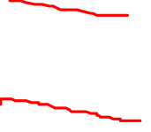
Divide-and-Conquer
Divide-and-Conquer is one of the three overarching algorithm design philosophies that we will study this semester.
The other two are Dynamic Programming and Greedy Algorithms
Divide-and-Conquer is a recursive paradigm:
“Divide the problem into a number of subproblems that are smaller instances of the same problem.
“Conquer the subproblems by solving them recursively. If the subproblem sizes are small enough, however, just solve the subproblems in a straightforward manner.
“Combine the solutions to the subproblems into the solution for the original problem.”

Slide 4
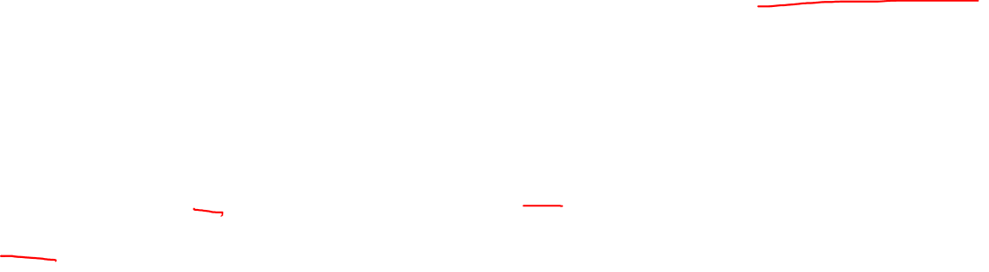
Example: Median of Two Sorted Arrays
Assume you have two sorted arrays of the same size n.
Define the median of the arrays to be the average of the two middle values of the pair of arrays.
Example: A = [1, 2, 3, 4, 6]; B = [5, 7, 8, 9, 10]; Median = 5.5
One could combine these into one large sorted array and average the two middle values in time Θ(n).
But there’s a divide-and-conquer algorithm that computes these in time Θ(log n).

Slide 5
Idea
Consider arrays A = [a₁,a₂,…,a_{n}] and B = [b₁,b₂,…,b_{n}].
Compare the middle elements of arrays A and B, namely a_{⎣n/2⎦} and b_{⎣n/2⎦} .
If a_{⎣n/2⎦} > b_{⎣n/2⎦} , the medians are in [a₁, …, a_{⎣n/2⎦}] and [b_{⎣n/2⎦} ,…, b_{n}]
If a_{⎣n/2⎦} < b_{⎣n/2⎦} , the medians are in [a_{⎣n/2⎦}, …, a_{n}] and [b₁ ,…, b _{⎣n/2⎦} ]
If a_{⎣n/2⎦} = b_{⎣n/2⎦} , that value is the median.
Recursively continue to do this until you either find the median or get down to two 2-element arrays.
In the latter case, sort the four elements in constant time (since there is a constant number of elements) and average the middle two elements.

Slide 6

Motivation for Recurrences
Recurrences are a way to figure out the complexity of recursive algorithms (such as Divide & Conquer)
Create a formula describing the running time T of a problem of size n in terms of smaller problems. Example:
Recall merge sort: To sort an array, divide it in half, sort each subarray separately, then merge the two sorted halves of the array together.
Merging the two arrays of size n/2 together takes time n. (You need to move each element once.)

Slide 7
Developing a Recurrence Equation
To determine the running time of a divide and conquer recursive algorithm, you need to figure out
How many recursive calls does it make, on what size problems
How much work is done when the recursion “bottoms out”

Slide 8
Analysis of the Medians Problem
The recurrence relation for this algorithm is
T(n) = T(n/2) + Θ(1)
We will show later that this is Θ(lg n)

Slide 9
Comment
You can also look at the maximum subarray problem in the text, sec. 4.1
You don’t need to.
Strassen’s algorithm, section 4.2, is very interesting if you want to multiply matrices, but it was allegedly just an “aha!” moment for Strassen, there’s no generalizable algorithm design technique involved.
We won’t cover it.

Slide 10
Example Recurrence Equation
public int fib( n )
if n==0 or n==1
return 1
else
return fib(n-1) + fib(n-2);
How many recursive calls?
2
On what size problems?
n-1 and n-2
How much work when recursion bottoms out?
Constant Θ(1)
T(n) = T(n-1) + T(n-2) + 1
More accurately, T(n) = T(n-1) + T(n-2) + Θ(1)

Slide 11

Methods of Handling Recurrences
Methods of handling recurrences:
Recursion Trees
Substitution
Master Method
We may, when appropriate, “play fast and loose” with things like floors and ceilings.
As when you do merge sort on an array of size != 2^{n}.
I handle recursion trees, the most general method, first.
Then proving what you find with recursion trees using substitution. Finally, the Master Method simplifies calculations for recursions in a certain format.

Slide 12
Recursion Trees
Useful to develop a good guess to the solution of a recurrence.
Also, if done very carefully, can be rigorous enough to prove bounds for a recurrence.
Basic idea: Draw a tree that shows, at each level of the recurrence, how many subproblems are generated, and their sizes.
See example, pp. 88-92, including proof that guess is correct using substitution.

Slide 13
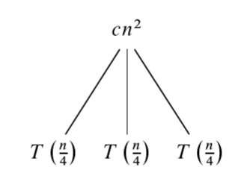
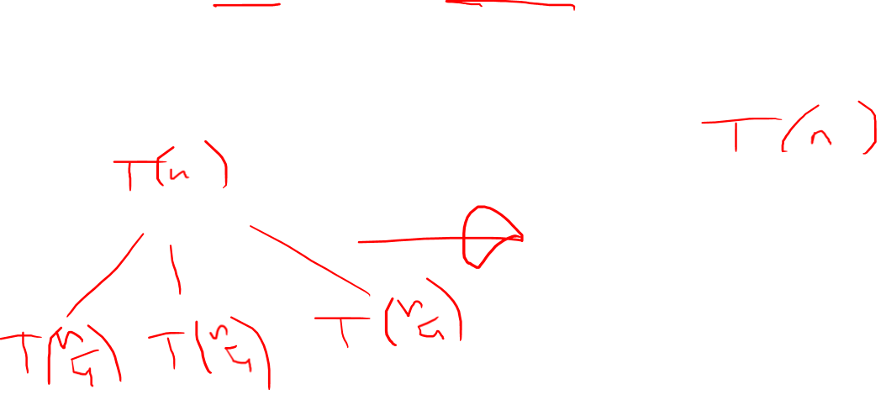
Example: T(n) = 3T(n/4) + cn²
We say cn² instead of Θ(n²) so we can do arithmetic easily.
First step of recursion tree:

Slide 14
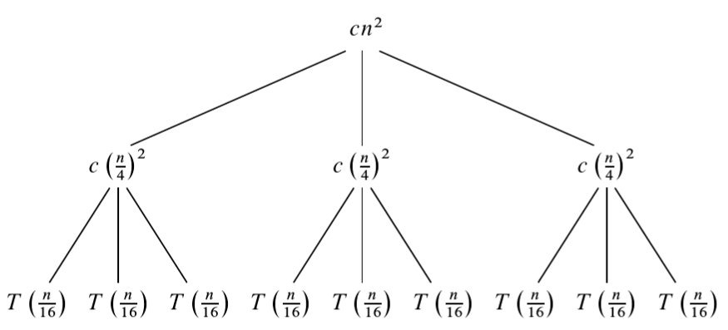
Example: T(n) = 3T(n/4) + cn²
Second step of recursion tree:
Each node (e.g., cn², c(n/4)²) represents the cost of a single subproblem

Slide 15
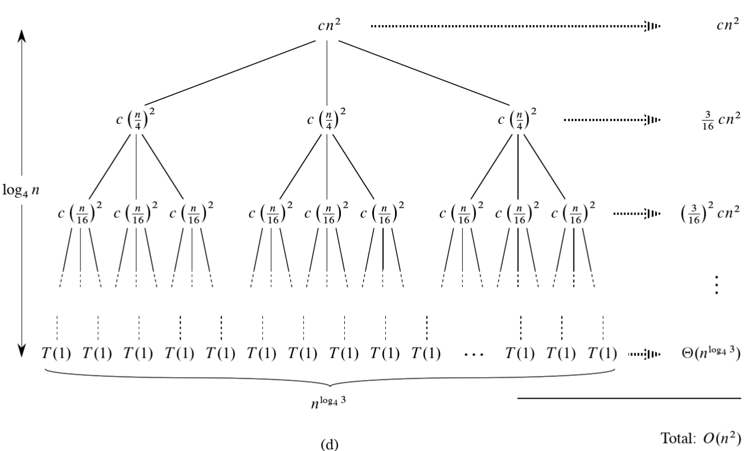
T(n) = 3T(n/4) + cn²
Sum the costs within each level to get the per-level cost
Sum the costs of all levels to get the total cost

Slide 16

How many levels? Call the root level 0.
Subproblem size for a node of depth i is n/4^{i}, so size hits n=1 at n/4^{i}=1, or i = log₄n.
So the recursion bottoms out after log₄n + 1 levels.

Slide 17
There are 3^{i} nodes at depth i.
Bottom level, at depth log₄n, has 3^{log4n} = n^{log43} nodes.

Slide 18
Summation
So the amount of work over all the levels is
Recall that for 0 <x< 1:
So
So the work is between cn² and (16/13) cn² = Θ(n²)
From the summations in Appendix B of CLRS
Or you can remember summations from your math classes.

Slide 19
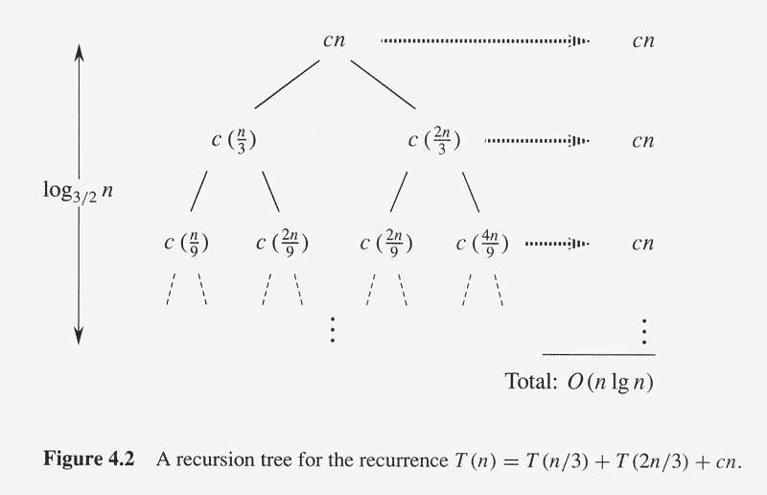
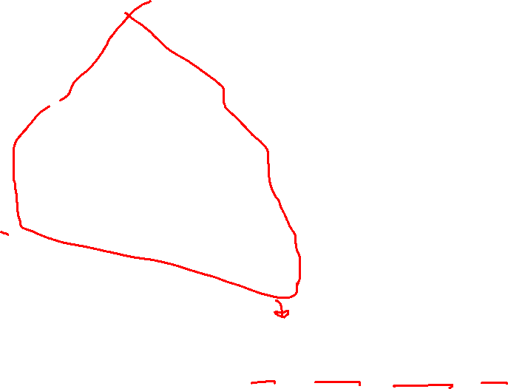


For low enough levels, some of these terms drop out, so
cn log_{3/2} n = O(n lg n) is a loose upper bound for the recursion. (going down the right subtree)

Slide 20

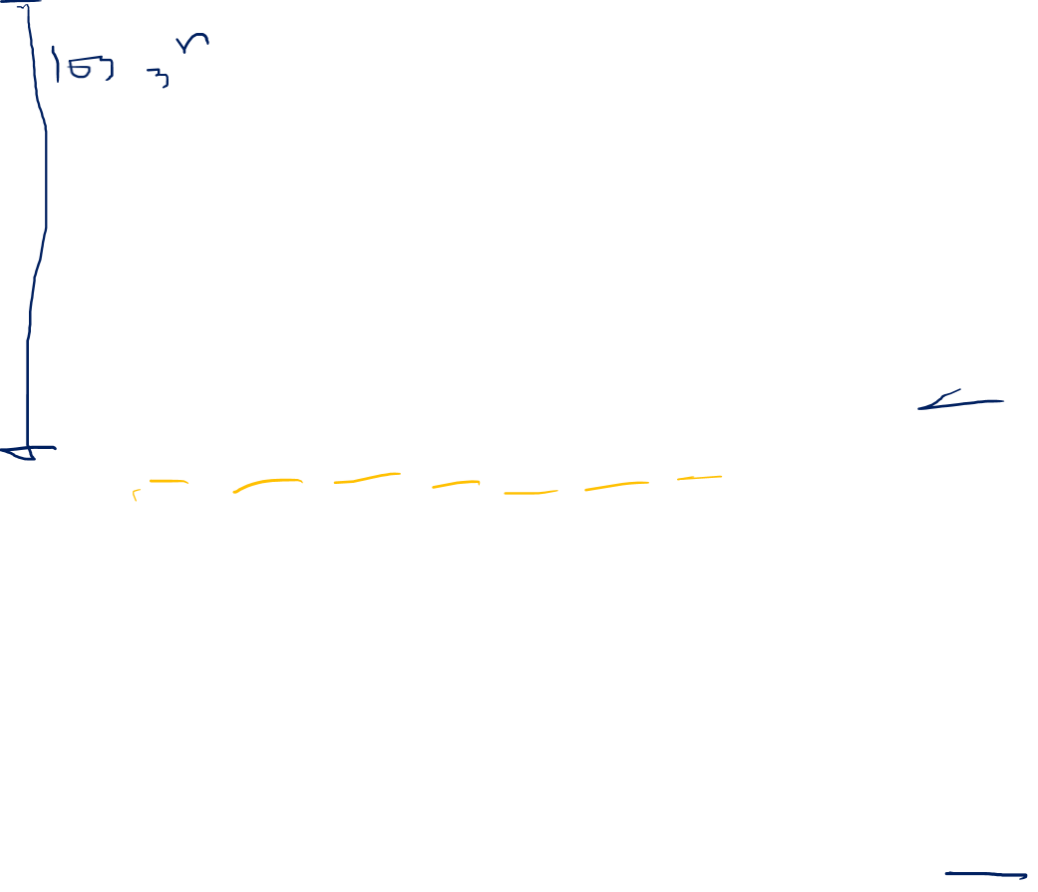

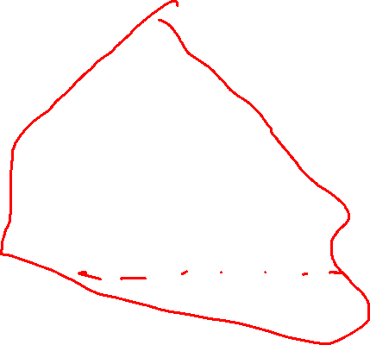
Similarly, going down the left subtree, cn log₃ n = Ω(n lg n) is a loose lower bound for the recursion. . T(n) = Θ(n lg n).

Slide 21
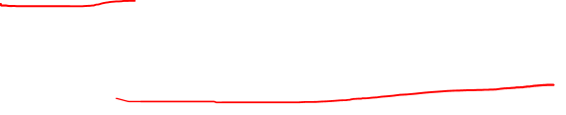
Substitution method
Guess the form of solution
Use mathematical induction to prove the guess.
This requires generating a good guess for the solution of the recurrence!
This guess is often generated by the use of recursion trees.

Slide 22

Example 4.19 – part 1
T(n) = 2T(⎣n/2⎦)+n
Suppose we think, from a recursion tree perhaps, that T(n) = O(n lg n). To prove this, we need to prove that for some positive constant c,
T(n) ≤ cn lg n.
Inductively, assume that this holds for all m ≤ n, in particular for m = ⎣n/2⎦. Then:
T(⎣n/2⎦) ≤ c ⎣n/2⎦ lg(⎣n/2⎦).
Substitute into the recurrence:
T(n) ≤ 2c ⎣n/2⎦ lg(⎣n/2⎦) + n

Slide 23

Example 4.19 – part 2
From last slide:
T(n) ≤ 2c ⎣n/2⎦ lg(⎣n/2⎦) + n
T(n) ≤ cn lg(n/2) + n ignore the floors
T(n) ≤ cn lg n – cn lg 2 + n by properties of logs
T(n) ≤ cn lg n – cn + n lg 2 = 1
T(n) ≤ cn lg n for c ≥ 1
I’ll let you read about the “base case” for the recursion on p. 84, it’s beyond the “median” level of the course.
Here I proved an upper O() bound, but substitution can also be used to prove lower Ω() bounds or tight Θ() bounds.

Slide 24
Advanced Substitution Tips and Tricks
Sometimes we “adjust” boundary conditions to ignore small n.
Read the “subtleties” and “Avoiding pitfalls” sections of the text – note hint about subtracting a term.
Remember the old calculus trick of changing variables.
See example, p. 86
Don’t sweat these, though.

Slide 25
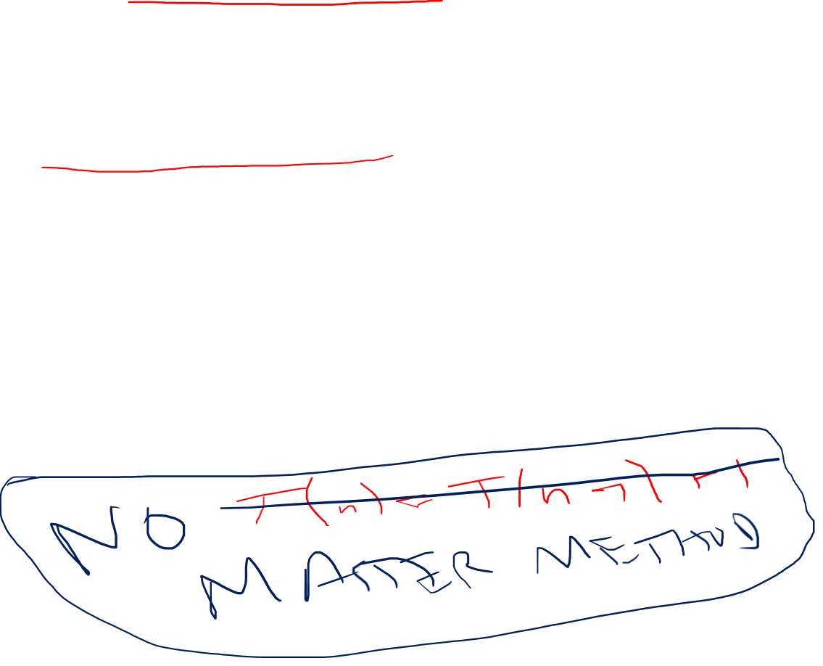
Master Method
Used to solve recurrences of the form
T(n) = a T(n/b) + f(n)
where a ≥ 1, b > 1, and n/b can also be ⎣ n/b ⎦ or ⎡ n/b ⎤.
Proof beyond the scope of this course.
Really common form of recurrence.
Key question: Which is bigger:
n^log_{b}a, or f(n)

Slide 26
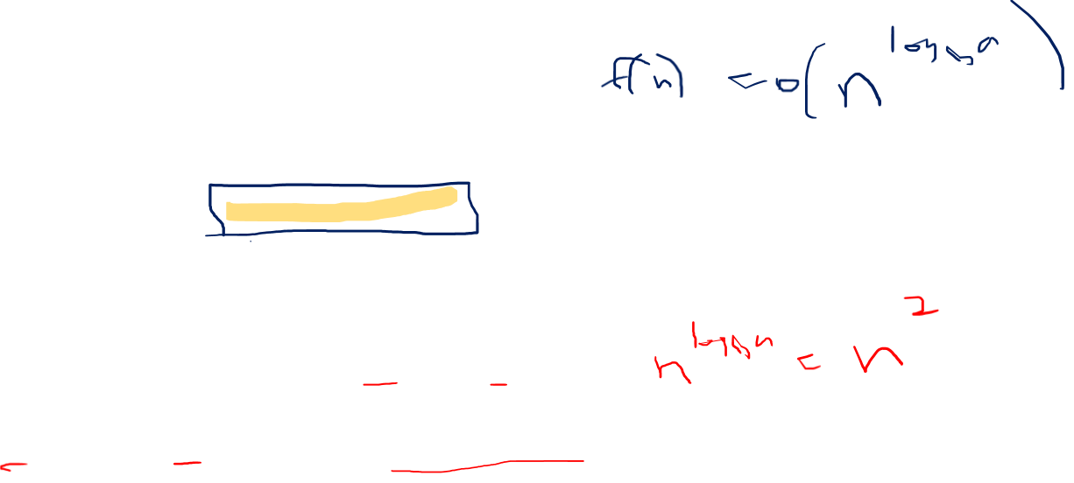
Master Method: Case 1
Recall T(n) = a T(n/b) + f(n)
If f(n) = O( n^{log}_{b}^{a-ε} ), for some constant ε>0, T(n ) is Θ ( n^{log}_{b}ª).
That is, f(n) is smaller than n^{log}_{b}ª
f(n) must be polynomially smaller than n^{log}_{b}ª
Logarithmically smaller doesn’t count
For instance, T(n) = 4T(n/2) + 1
a = 4, b = 2, f(n) = 1. f(n) = Θ(1), so T(n) = Θ(n²)
But T(n) = 4T(n/2) + (n² / lg n) doesn’t work.
F(n) not polynomially smaller than n².

Slide 27
Master Method: Case 2
Recall T(n) = a T(n/b) + f(n)
If f(n) = Θ( n^{log}_{b}ª ), T(n ) is Θ(n^{log}_{b}ª lg n).
That is, f(n) is the same order as n^{log}_{b}ª
For instance, T(n) = 4T(n/2) + n²
a = 4, b = 2, f(n) = Θ(n²), T(n) = Θ(n² lg n)
Note: On the internet, you can find a more general form of Case 2 that works for more recurrences, but we won’t be using this.
You can use it if you want to, if you get a recurrence of the right form.

Slide 28
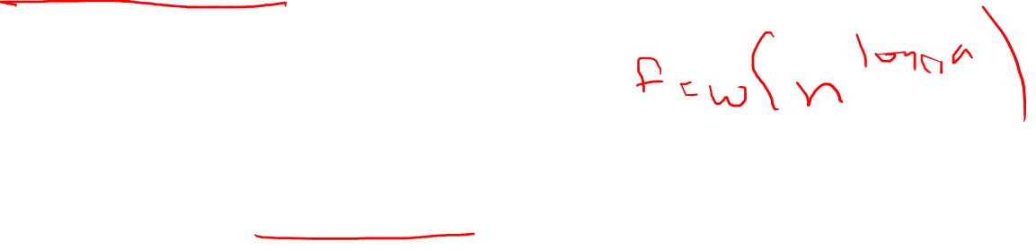
Master Method: Case 3
Recall T(n) = a T(n/b) + f(n)
If f(n) = Ω( n^{log}_{b}^{a+ε} ), for some constant ε>0, and if af(n/b) ≤ c f(n) for some c < 1 and n > n₀, T(n ) is Θ ( f(n) ).
That is, f(n) is bigger than n^{log}_{b}ª
f(n) must be polynomially bigger than n^{log}_{b}ª
Logarithmically bigger doesn’t count
For instance, T(n) = 4T(n/2) + n³
a = 4, b = 2, f(n) = n³. f(n) = Θ(n³), so T(n) = Θ(n³)
But T(n) = 4T(n/2) + n² lg n doesn’t work

Slide 29
Master Method Case 3 – Regularity Condition
For case 3 to hold, the following must also be true:
For some c with 0 < c < 1, af(n/b) ≤ cf(n) for all n big enough.
Example: T(n) = 4T(n/2) + n³.
Must show 4(n/2)³ ≤ cn³
n³/2 ≤ cn³, so ½ ≤ c < 1 works for all n > 1
Θ
Θ

Slide 30
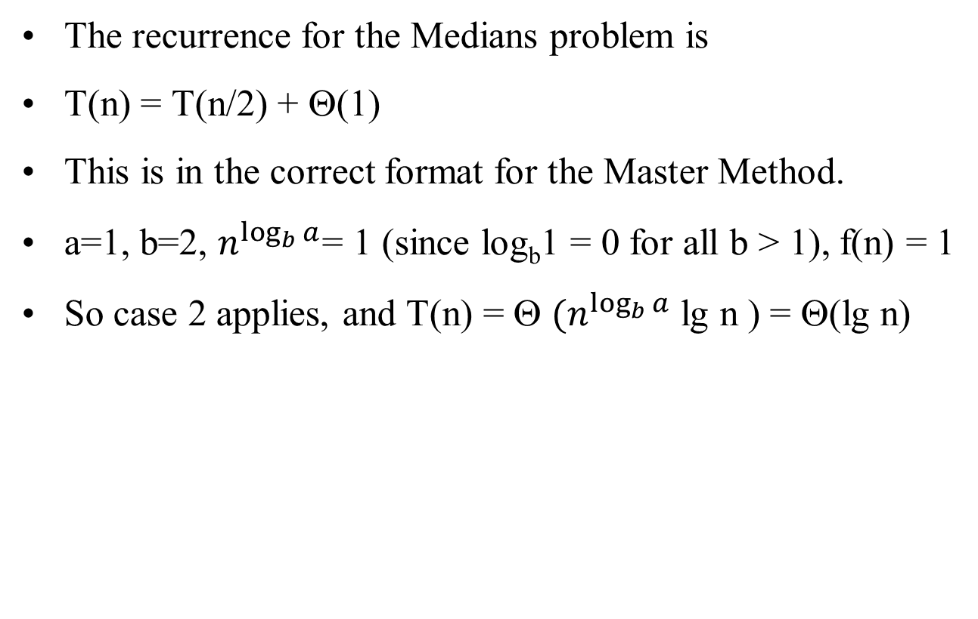
Running Time of Medians Problem
The recurrence for the Medians problem is
T(n) = T(n/2) + Θ(1)
This is in the correct format for the Master Method.
a=1, b=2, $n^{\log_{b}{a}}$= 1 (since log_{b}1 = 0 for all b > 1), f(n) = 1
So case 2 applies, and T(n) = Θ $(n^{\log_{b}{a}}$ lg n ) = Θ(lg n)

Slide 31
Master Method - Summary
Recall T(n) = a T(n/b) + f(n)
If f(n) = O( n^{log}_{b}^{a-ε} ) for some constant ε>0, T(n ) is Θ ( n^{log}_{b}ª ).
If f(n) = Θ( n^{log}_{b}ª ), T(n ) is Θ(n^{log}_{b}ª lg n).
If f(n) = Ω( n^{log}_{b}^{a+ε} ) for some constant ε>0, and if af(n/b) ≤ c f(n) for some c < 1 and n > n₀, T(n ) is Θ ( f(n) ).

